Slide 1
Teaching notes for “Distributional preferences in larger groups”
July 2, 2020

Slide 2
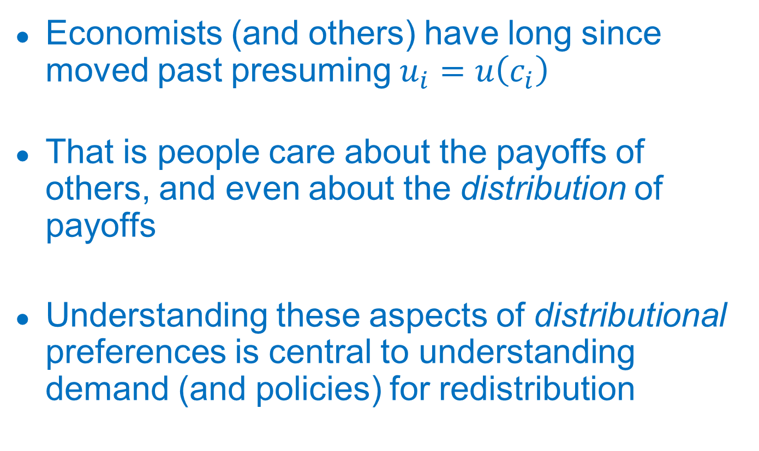
Distributional preferences and redistribution
Economists (and others) have long since moved past presuming $u_{i}=u\left(c_{i}\right)$
That is people care about the payoffs of others, and even about the distribution of payoffs
Understanding these aspects of distributional preferences is central to understanding demand (and policies) for redistribution
Notes:
For the first one, we’ll see the crazy implications in a sec.

Slide 3
Building blocks of distributional prefs
Theory: standard models (including Fehr and Schmidt, which we work from) put a lot of structure on particular distributional concerns (e.g., same weight on inequality relative to all individuals above self)
Experiments: much of extant evidence (in favor of difference-aversion models etc) is based on 2-3 person dictator games

Slide 4
Our experiment
We aim to understand whether there is a particular structure to distributional preferences (e.g., regard for particular individuals’ incomes relative to self)
Motivation:
  To better inform modeling of distributional preferences
  Ultimately to contribute to understand of demand for redistribution

Slide 5
Our experiment (cont’d)

Slide 6
Our experiment (cont’d)
Subjects make a series of decisions between pairs of “societies” in which own-income is identical, but other incomes vary
We pool subjects’ decisions to assess the extent to which subjects are concerned (on average) with different components of inequality

Slide 7
Main results
Unsurprising but comforting (for the methodology):
  Subjects are much more likely to pick distributions that increase the worst-off member of society and decrease the best-off (holding total income constant)
Perhaps more surprising (but not completely so):
  Subjects are particularly concerned with lowering the incomes of those directly above them (“keeping up with the Jones’”)

Slide 8
Comparison to earlier papers
We’re not the first to consider this type of “large group” redistributive exercise, but previous work (see esp Durante et al, 2014) essentially impose a standard tax formula that doesn’t allow for subjects to express differential concern for some particular high (or low) income individuals
[Relatedly, standard Meltzer-Richard model of redistribution limit the set of policies available to voters]

Slide 9
Distributional Preferences in Larger Groups
Benchmark model
Experimental design
Data collection
Main Results

Slide 10
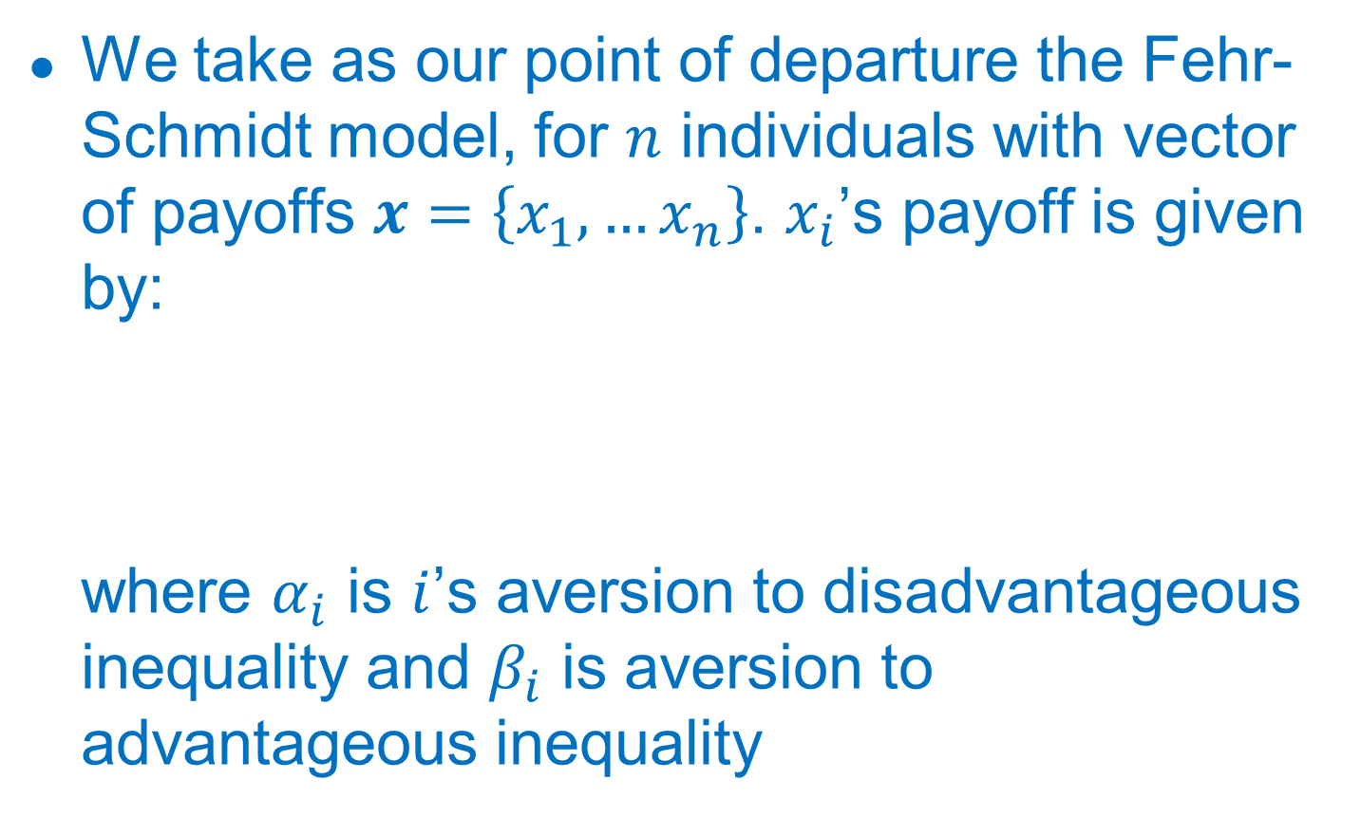
Benchmark model
We take as our point of departure the Fehr-Schmidt model, for $n$ individuals with vector of payoffs $x=\left\{x_{1},…x_{n}\right\}$. $x_{i}$’s payoff is given by:
where $α_{i}$ is $i$’s aversion to disadvantageous inequality and $β_{i}$ is aversion to advantageous inequality

Slide 11
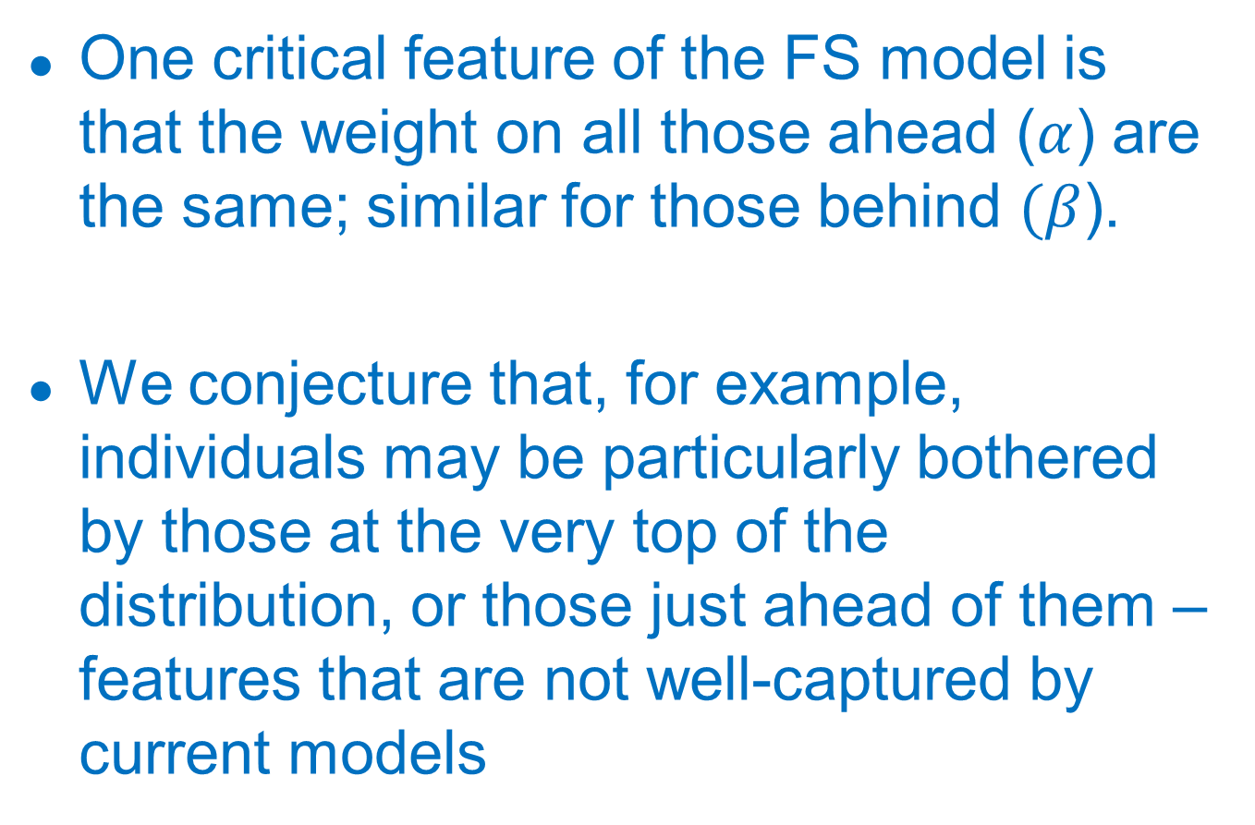
Benchmark model (cont’d)
One critical feature of the FS model is that the weight on all those ahead ($α$) are the same; similar for those behind $(β$).
We conjecture that, for example, individuals may be particularly bothered by those at the very top of the distribution, or those just ahead of them – features that are not well-captured by current models

Slide 12
An extension of FS
We simply allow these utility weights to vary, then ask what the data suggest about their relative values. That is, an augmented FS model has a position-specific weight:
The basic purpose of our experiment is to take a first step in estimating these weights

Slide 13
Experimental design and results: note
In these teaching notes, we focus exclusively on the “main” sample, collected in 2014. Further experiments were run in later years to address concerns of interpretation and robustness; these findings are discussed in the paper.

Slide 14
Basic instructions
“In each round you will see two graphs displayed on your screen. Each graph represents a distribution of payoffs that you can choose to assign to yourself and to the other participants in your group. In each round, you must decide which distribution, Society A or Society B, you prefer.”

Slide 15
Each decision problem

Slide 16
Each decision problem (cont’d)
Income generating process:
  Each income in each septile is drawn at random from a pre-determined range
  We allowed for a variety of ranges (e.g., same absolute width (20K), roughly constant percentage increase)
The subject’s own income (highlighted in red) is identical in each distribution, to focus subjects’ attention on their position relative to others
[See www.nautech-clients.com/tobin/survey12/ to take the experiment]
Each subject completed 10 decisions

Slide 17
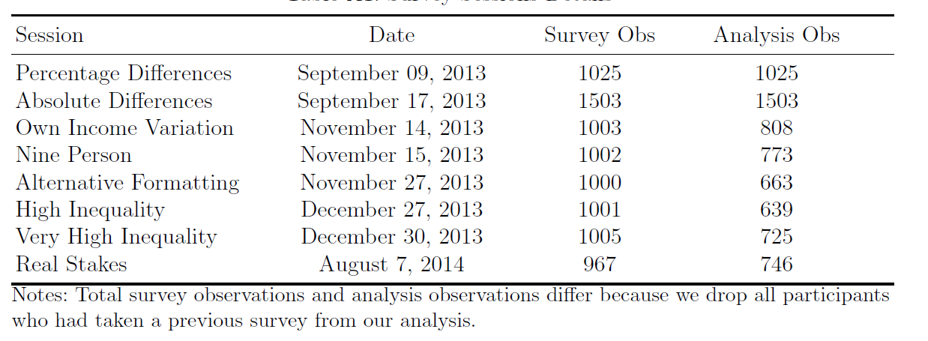
Range of treatments in 2013-14

Slide 18
Data collection
Via mTurk
Various standard attempt made to ensure that respondents are not robots, and that they reside in the U.S.
Subjects differ from U.S. population in expected ways
Notes:
e.g., prompted for responses; work hours on east coast, cats, etc.

Slide 19
Sample sociodemographics

Slide 20
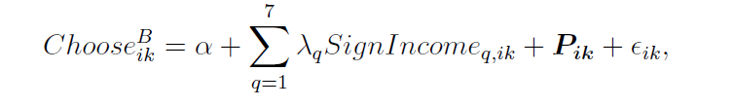
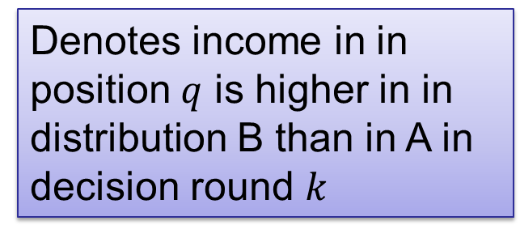
Main specification
Denotes income in in position $q$ is higher in in distribution B than in A in decision round $k$
Position fixed effect

Slide 21
Concern for the tails

Slide 22
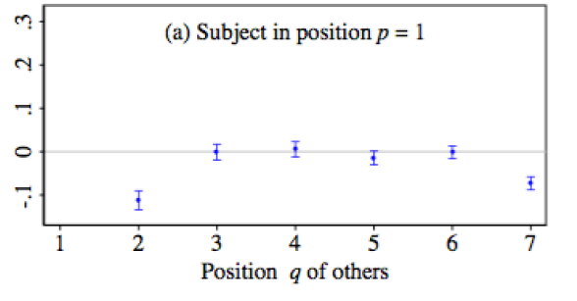
Concern for the neighbors

Slide 23
Regression results

Slide 24
Heterogeneity
Notes:
This tells us that concern for the tails is more extreme for those with attributes that would assign them as having ex ante greater concern for equality. But the main takeaway is concern for those just-above seems to transcend that – the coeffs look pretty similar for the first two rows. (if anything goes in the “wrong” direction)

Slide 25
Summary of main results
Individuals show particular concern for:
  Raising bottom incomes
  Reducing top incomes
  Lowering those just above them
The first of these fits straightforwardly with Rawlsian preferences; the latter two are distinct from extant models, though consistent with popular narratives of preferences for “soaking the rich” and “keeping up with the Jones’”

Slide 26
Comparison to FS model
We can highlight the importance of allowing the data to guide these social preference parameters by comparing the predictions of our model to that of the FS formulation, which imposes constant weights on disadvantageous inequality and also advantageous inequality.
On the next two slides, we contrast our predictions versus those of the FS model

Slide 27
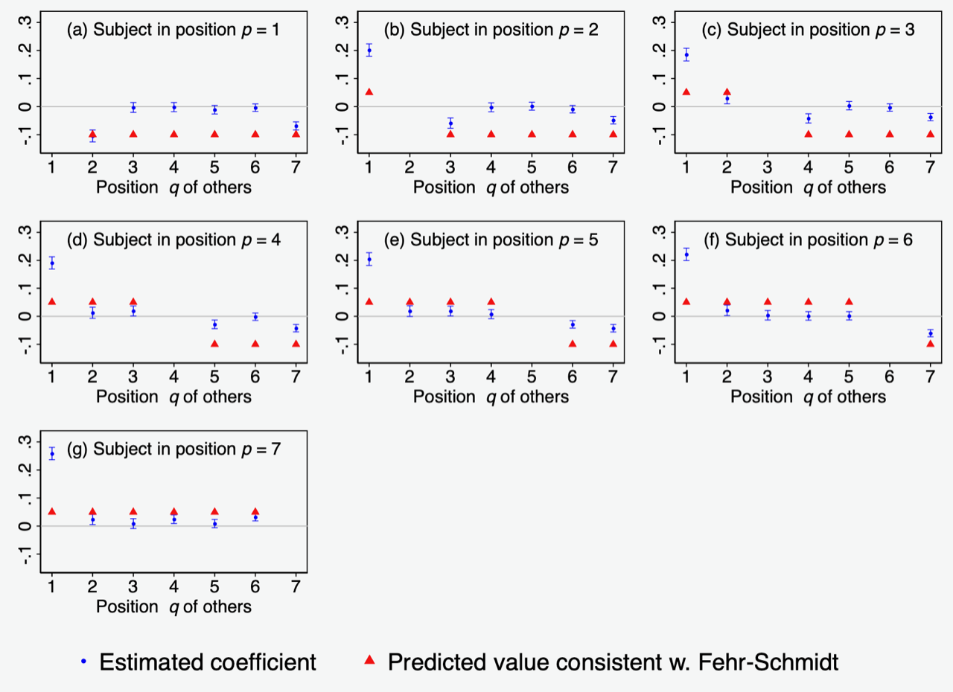
Predictions from FS model

Slide 28
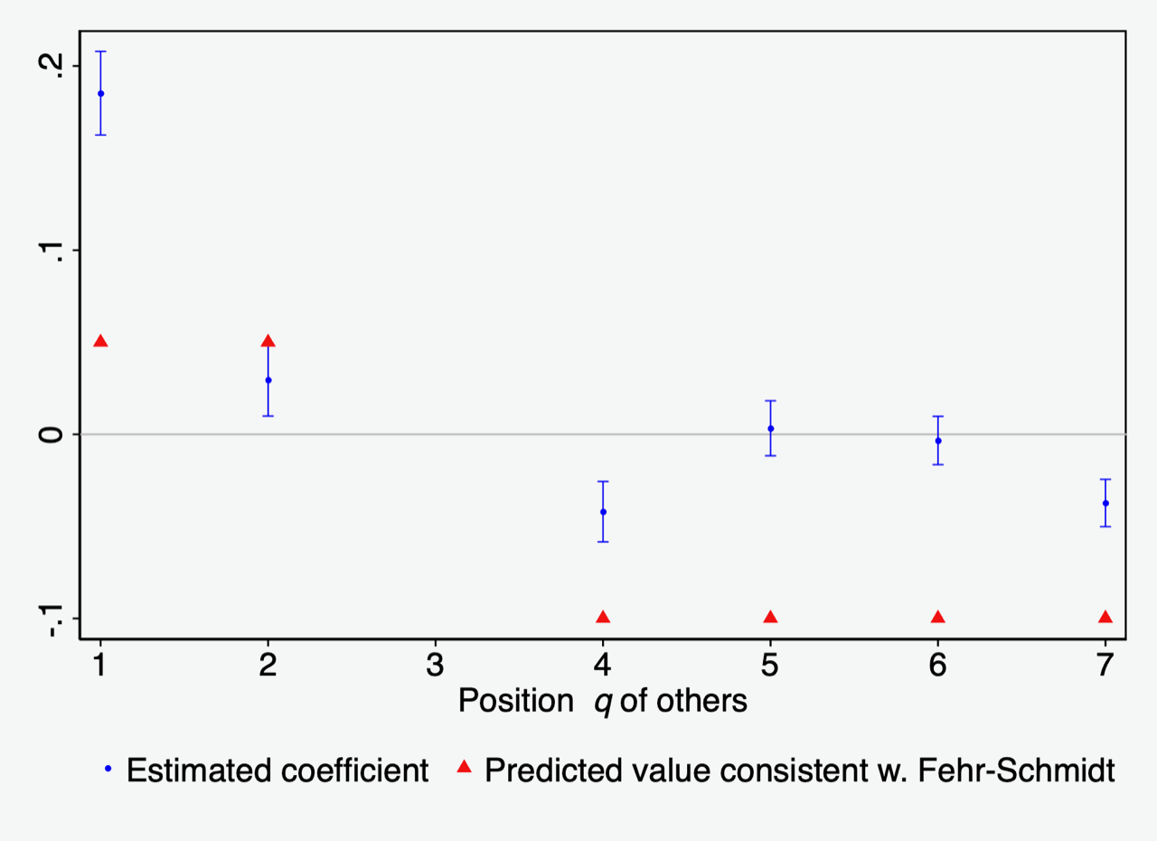
FS model for person in position 3

